Slide 1
Directives

Slide 2
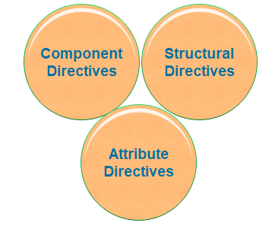
Directives are instructions in the DOM (Document Object Model). It specifies how to place our business logic in Angular.
By using Angular directives, you can change the appearance, behavior or a layout of a DOM element. It also helps you to extend HTML.
There are three kinds of directives:
1. Component Directives
2. Structural Directives
3. Attribute Directives

Slide 3
Component Directives
Components are the most common of the directives.
It contains the details of how the component should be processed, instantiated, and used at runtime.
The component comprises meta-data.

Slide 4



Structural Directives
These directives are used to manipulate and change the structure of the DOM elements.
Structural directives have a star (*) sign before the directive.
Like as,* ngIf, *ngFor, and *ngSwitch directive.
*ngIf Directive: The *ngIf allows us to Add/Remove DOM Element.
*ngSwitch Directive: The *ngSwitch will enable us to Add/Remove DOM element.
*ngFor Directive: The *ngFor directive is used to repeat a part of HTML template once per each item

Slide 5

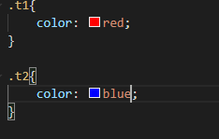


Attribute Directive
It deals with changing the look and behavior of the DOM element. For example: ngClass, ngStyle etc.
NgClass Directive: The ngClass Directive is used to add or remove CSS classes to an element.
ngStyle
The ngStyle Directive facilitates you to modify the style of an HTML

Slide 6
Practise
Add A button which says 'Display Details‘
Add a paragraph with any content of your choice (Hello User)
Toggle the displaying of that paragraph with the button created in the first step
Create other button which displays the values one by one from other array for every click
Starting at the 5th log item, give all future log items a blue background (via ngStyle) and white color (ngClass)

